Slide 1
Data type Modifiers
Presented by Nitin Mogalapalli

Slide 2
Data type modifiers in C
In c language Data Type Modifiers are keywords used to change the properties of current properties of data type. Data type modifiers are classified into following types.
long
short
unsigned
signed

Slide 3
Contd….
Modifiers are prefixed with basic data types to modify (either increase or decrease) the amount of storage space allocated to a variable.
For example, storage space for int data type is 4 byte for 32 bit processor. We can increase the range by using long int which is 8 byte. We can decrease the range by using short int which is 2 byte.

Slide 4
long:
This can be used to increased size of the current data type to 2 more bytes, which can be applied on int or double data types.
For example int occupy 2 byte of memory if we use long with integer variable then it occupy 4 byte of memory.

Slide 5
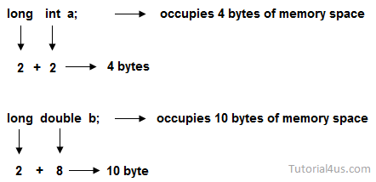
long

Slide 6
short
In general int data type occupies different memory spaces for a different operating system; to allocate fixed memory space short keyword can be used.

Slide 7
unsigned
This keyword can be used to make the accepting values of a data type is positive data type.

Slide 8
Signed
This keyword accepts both negative or positive value and this is default properties or data type modifiers for every data type.

